Slide 1
AETHERIX TELECOM
EDA REPORT

Slide 2
BUSINESS UNDERSTANDING AND OVERVIEW
We are tasked to analyse the customers who churn
We performed Exploratory Data Analysis (EDA) in order to obtain actionable insights and present them in a meaningful way for the company to take necessary actions to retain their customers

Slide 3
UNDERSTANDING THE DATA

Slide 4
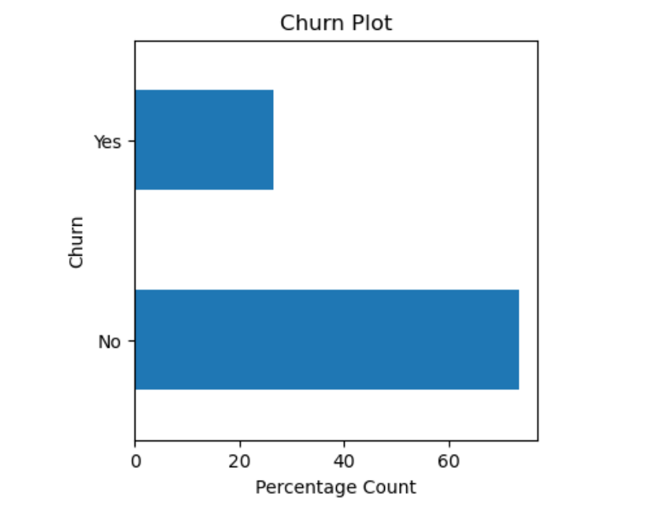
TARGET VARIABLE
Findings
Data is highly inbalanced, at a ratio of almost 3:1
About 26.54% of customers have churned
More analysis will be run while taking the target values into account

Slide 5
MISSING VALUES
Findings
After the conversion of ‘totalcharge’ column to the appropriate data type, turns out the column has missing values
There were only 11(0.16%) missing values, which is quite insignificant
To that effect, we are going to delete the null values

Slide 6
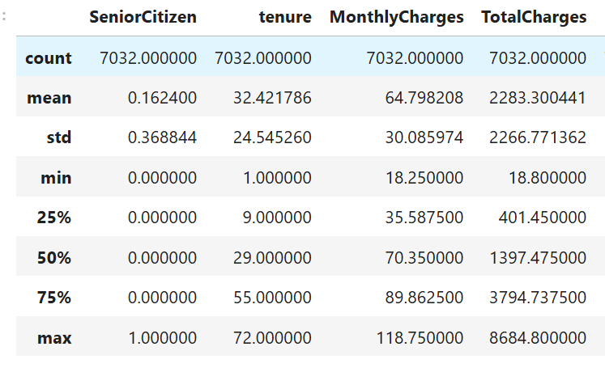
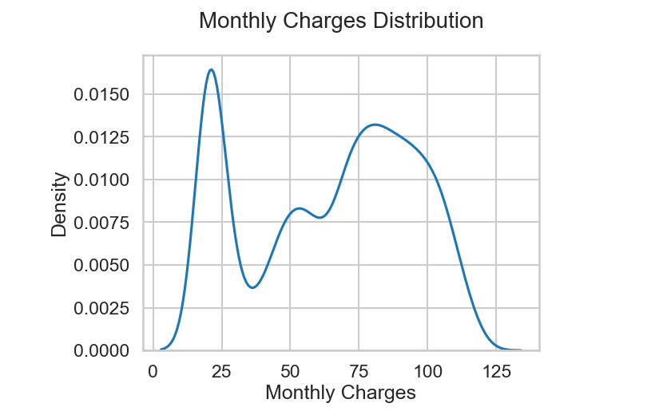
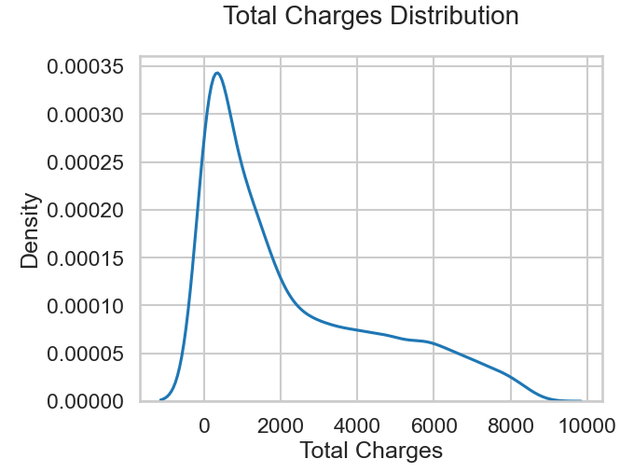
INITIAL INTUITION FROM DATA
Findings
‘SeniorCitizen’ column is actually a categorical variable hence this analysis doesn't apply to it
25% of the customers are high value customer pay monthly charges > $89.86
While 25% of the customers churn at tenure ≤ 9
Half of the customers have been with the company less than 30 months
Minimum Monthly Charges $18.25 while max is $118.75
Monthly Charges have slightly right skewed due to many low paying customers
Total Charges have strong right skew owing to the few loyal high value customers

Slide 7
UNIVARIATE ANALYSIS

Slide 8
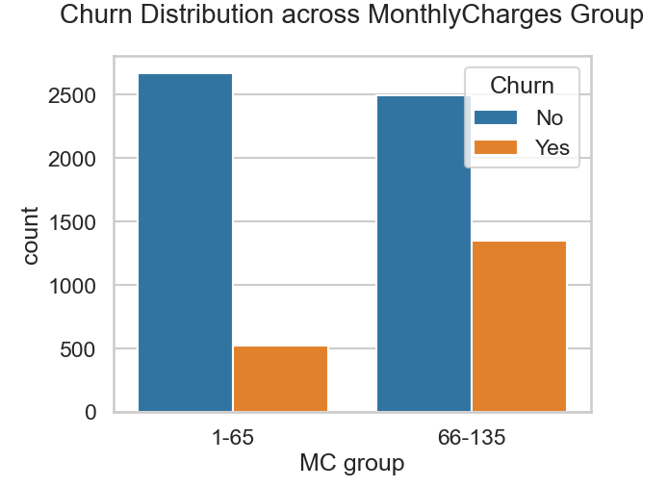
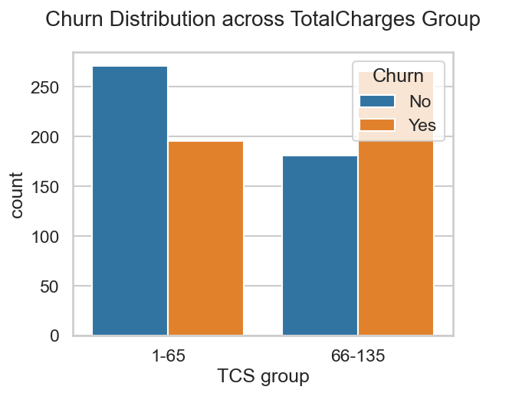
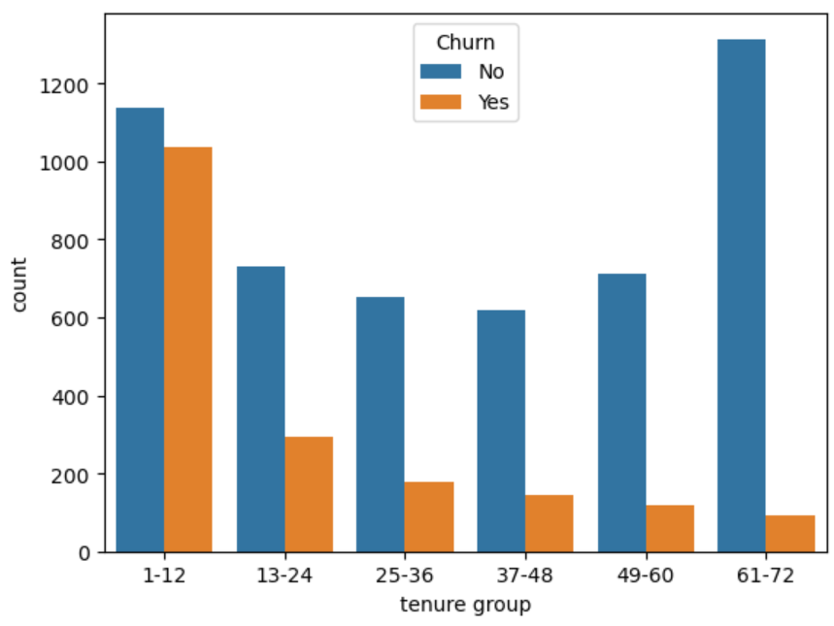
CHURN VS OTHER FEATURES
Findings
Customers paying above the mean ‘MonthlyCharges’ ($65), will be regarded as High paying customers
High paying customers tend to churn more
These customers tend to churn relatively quick (within1-12month tenure group)

Slide 9
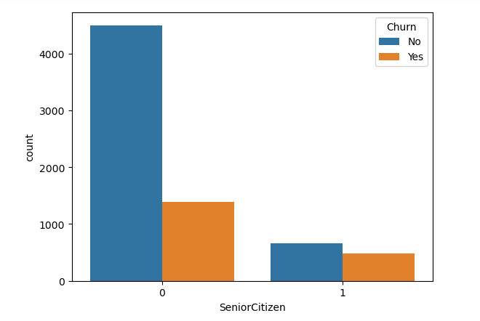
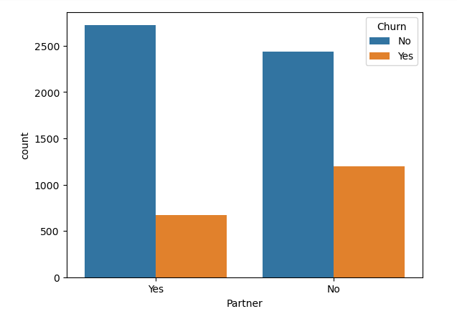
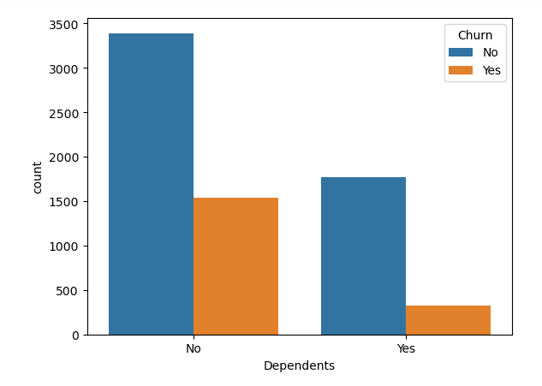
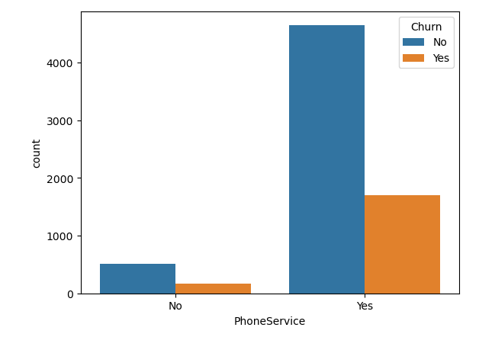
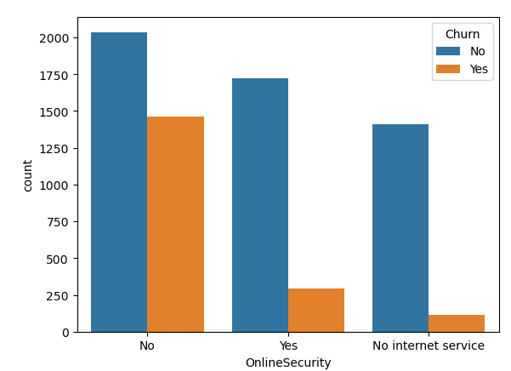
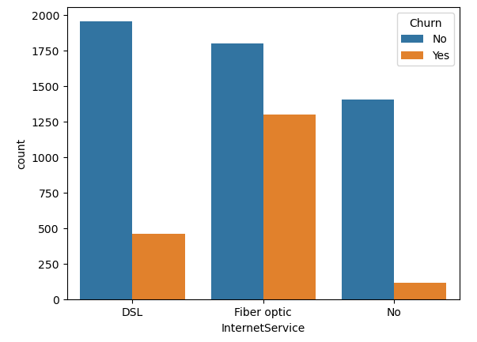
CUSTOMERS MORE LIKELY TO CHURN CONT’D
Findings
Non-senior citizens
Customers who don't have partners, as well as those with no dependents
Customers with no dependents
Those with phone services
Those who have internet services (esp. fibre optic services)
Customers with no online security

Slide 10
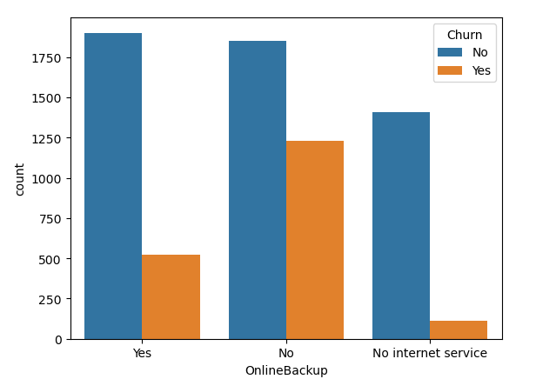
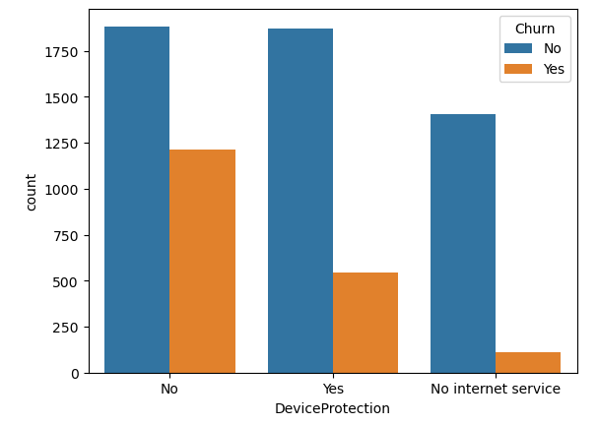
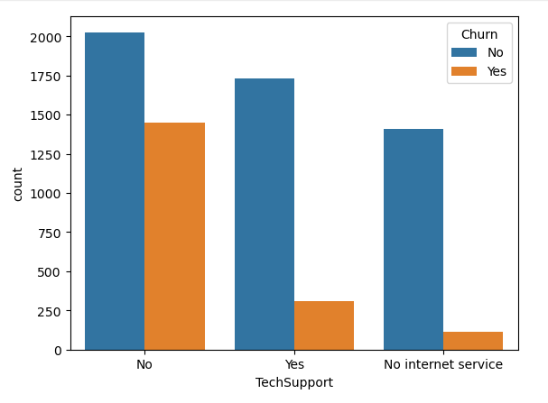
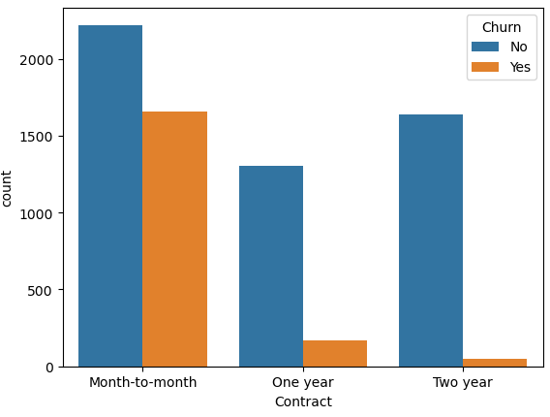
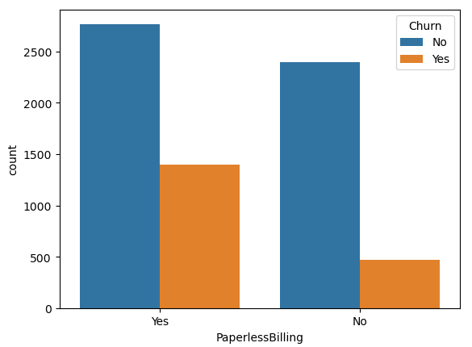
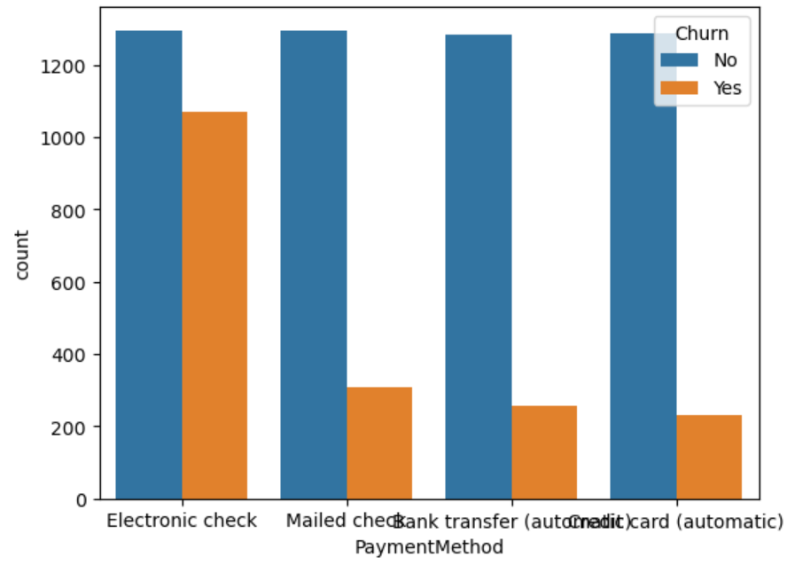
Customers more likely to churn cont’d
Those with no device protection
Those with monthly subscriptions/contracts
Those with no tech support, which in turn can translate to those with paperless billing
Those who make payments using electronic checks
Those with no online backup

Slide 11
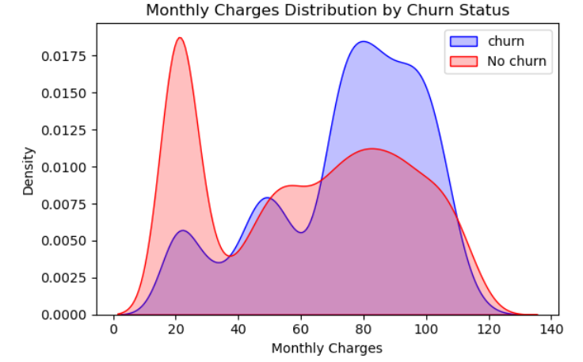
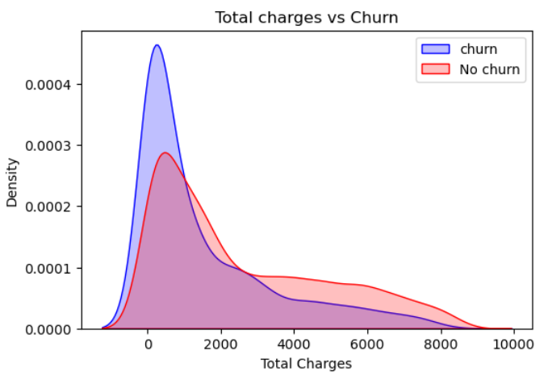
CHARGES VS CHURN
Findings
Customers who pay high charges monthly churn more while those who pay less charges are more likely to stay
Since customers who pay high tend to churn more, hence causing total charges to peak towards the lower values.
This also show that customers are churn relatively quick making them unable to accumulate a higher total charges

Slide 12
Numeric and Bivariate Analysis

Slide 13
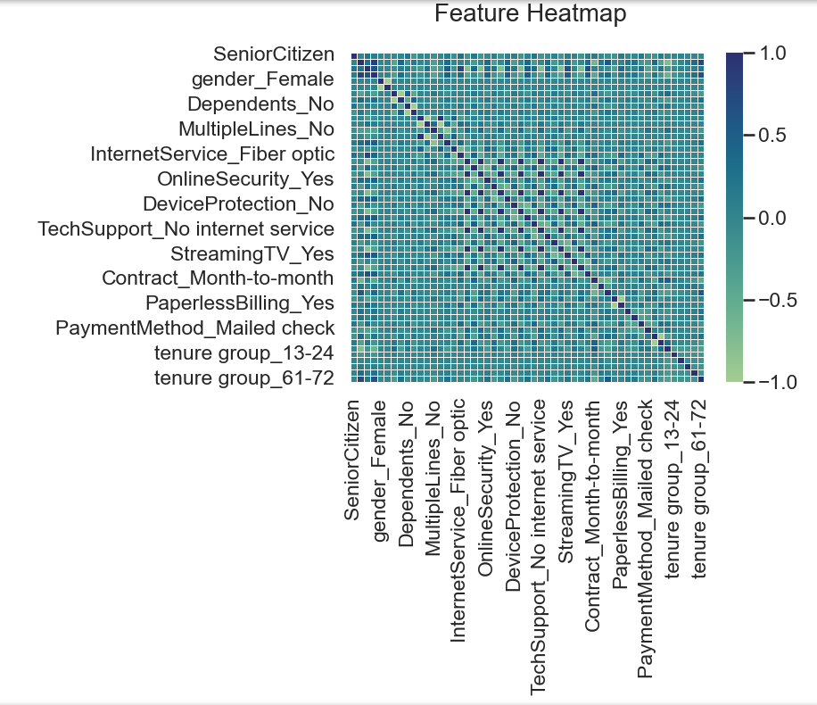
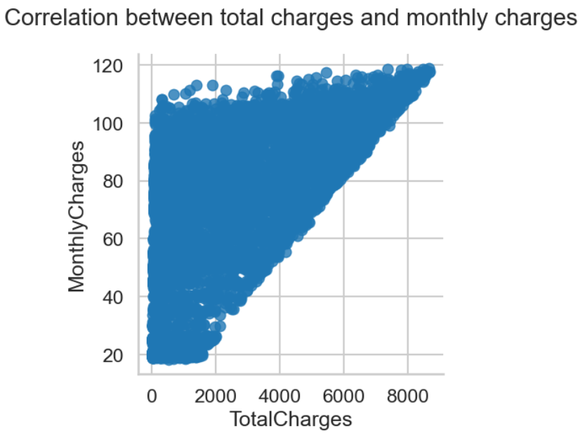
CORRELATION ANALYSIS
Findings
Monthly charges have a strong positive correlation with Total charges
Heatmap showing the correlation level of various features

Slide 14
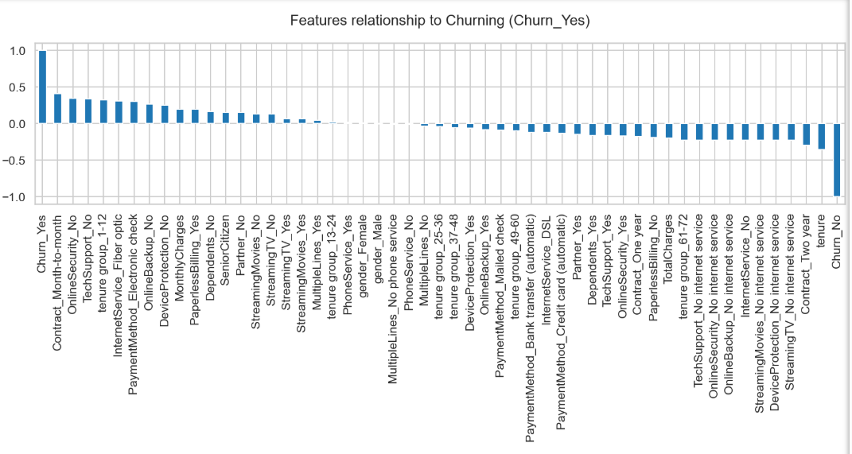
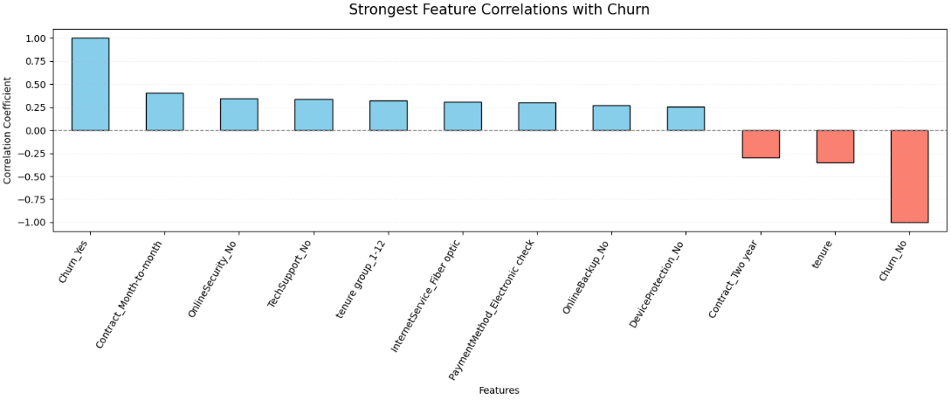
FEATURES CORRELATION WITH CHURNING
Findings
There are lot features in our data that affect churning both positively and negatively but we will focus on those that a high value of influence (0.25 upwards)
These are the 8 strongest features that encourages churning are: Contract_Month-to-month, no online security, no techsupport, tenure group_1-12 months, fibre optic internet service, electronic check payment method, no online backups, no device protection
We will focus on how these features influence churn rates

Slide 15
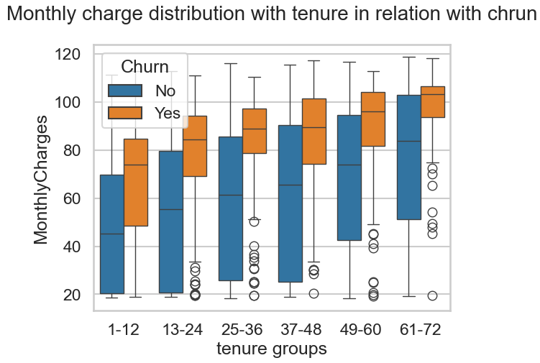
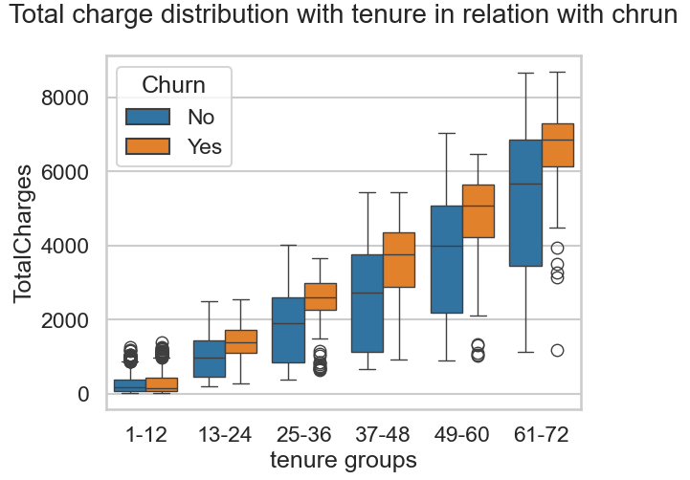
CHARGES AND TENURE GROUPS VS CHURN
Findings
High paying customers on monthly basis is high
This gap between churned high and low paying customers widens further as tenure increases especially from tenure 49 and above
More of the low paying customers are retained more as tenure increases

Slide 16
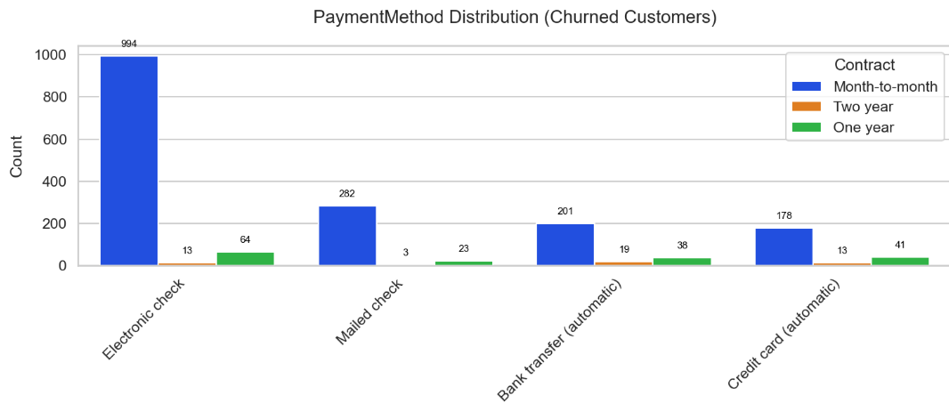
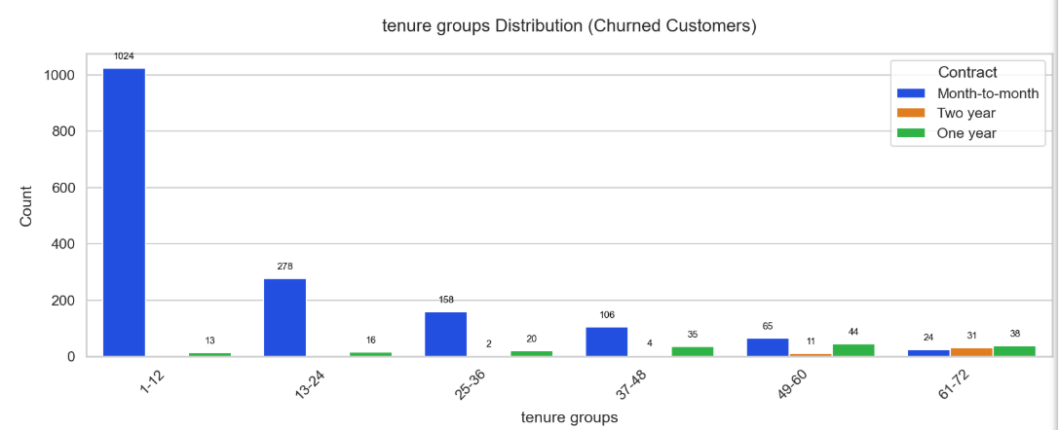
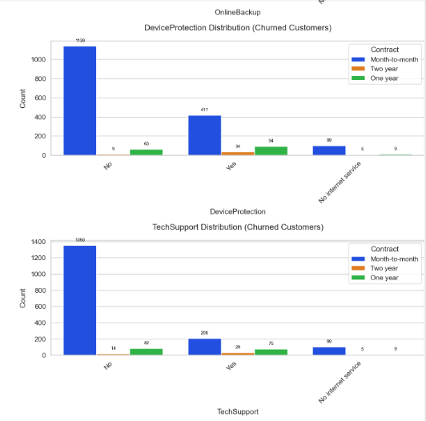
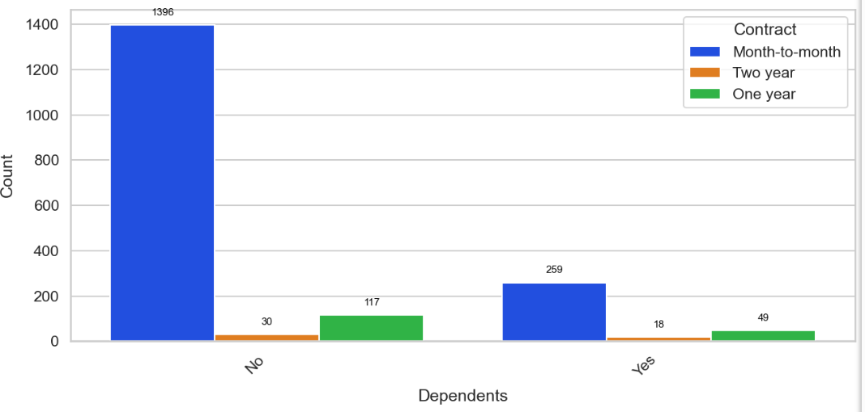
CONTRACT AND OTHER FEATURES VS CHURN
Finding
Most of the customers that churn are on month-month contracts across all categories
Non senior citizens who use electronic checks, have no online security/backup, and no device protection/partners/dependents and who have fibre optics tends to churn mostly tends to churn within 1-12 tenure groups

Slide 17
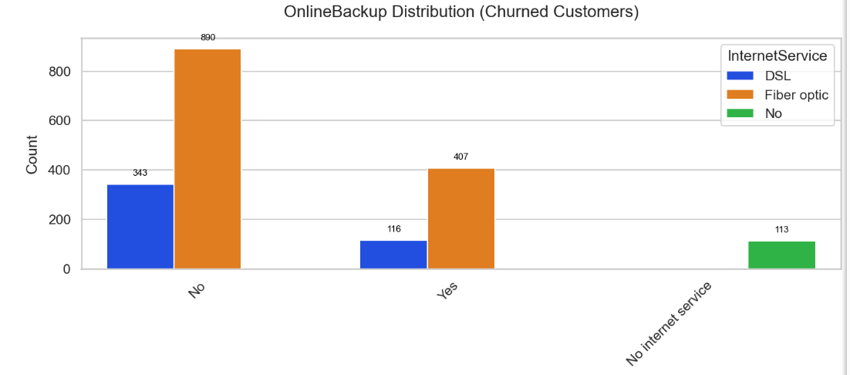
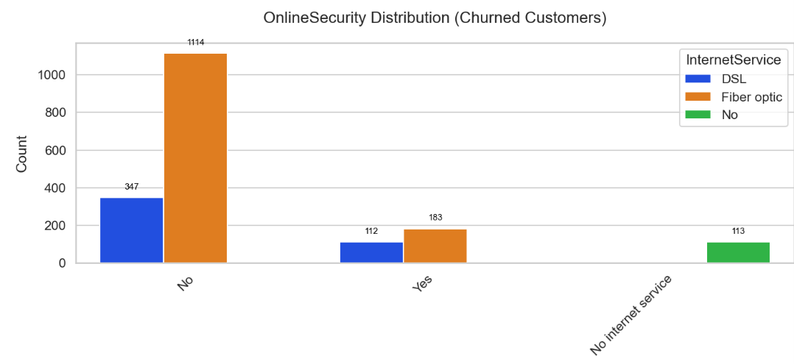

INTERNET SERVICES AND OTHER FEATURES VS CHURN
Finding
Non senior citizens who use electronic checks, have no online security/backup, and no device protection/partners/dependents and who have fibre optics tends to churn mostly tends to churn within 1-12 tenure groups

Slide 18
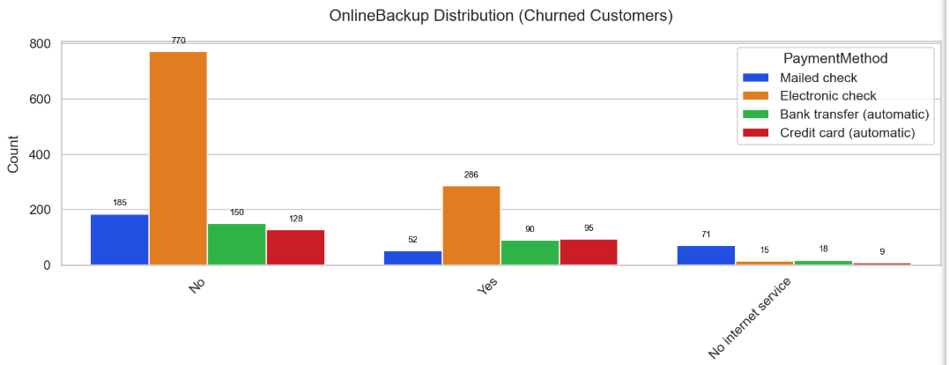
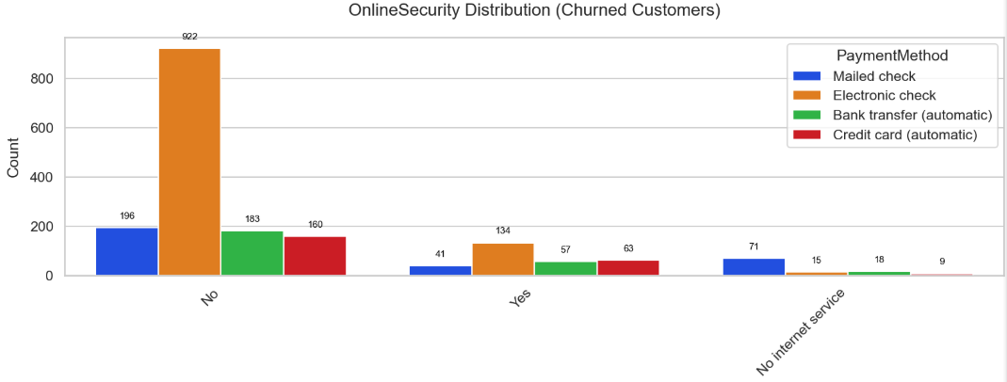
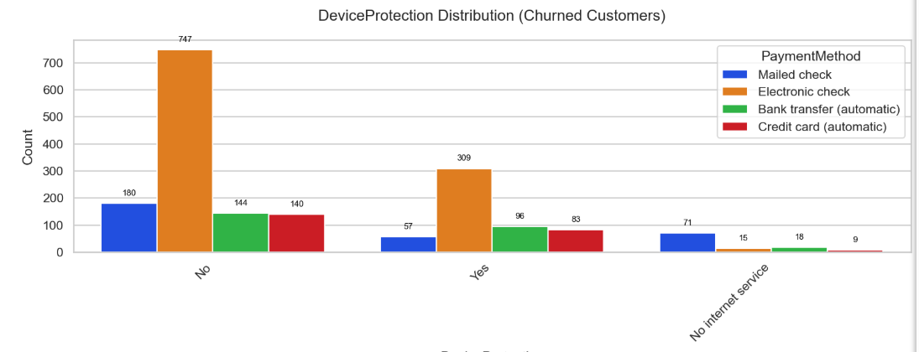
INTERNET SERVICES AND OTHER FEATURES VS CHURN
Finding
Non senior citizens who use electronic checks, have no online security/backup, and no device protection/partners/dependents and who have fibre optics tends to churn mostly tends to churn within 1-12 tenure groups

Slide 19
FINAL THOUGHTS
Most customers accumulate very little in total charges as they churn almost very quickly, so company should focus on early retention plans
Most churners are high paying non-senior citizens who don't have partners/dependents. A special plan(s) particularly targeted to them should be deployed.
They focus more on retaining their high paying customers as they are the ones more likely to terminate early due to high prices
Company should make electronic checks payment method more seamless to combat the high churning or promote other payment methods
Also customers who have no online security/online backup, and no device protection churn more hence, special packages/bundles should be made to address their challenge
High paying customers tend to churn more, hence the company should develop a premium plan that focuses more on retaining these customers as they have big influence on total charges.
Most customer customers who churn are on a ‘month-to-month’ contract, hence longer contracts should be encouraged as this will in turn lead to increased ‘totalcharges’
Customers who use ‘Fibre optics’ on ‘InternetServices’ seem to be highly dissatisfied as they churn way more than the others, hence this service quality should be reviewed and strengthened

